Slide 1

Next Generation Teaching and Learning
Charles Severance
Sakai PMC Chair
University of Michigan
20July-2016

Slide 2

Original Mission
Build a set of standards-based tool kits to greatly advance the state of the art of interoperability, reusability, and re-mixability for learning content and software.

Slide 3
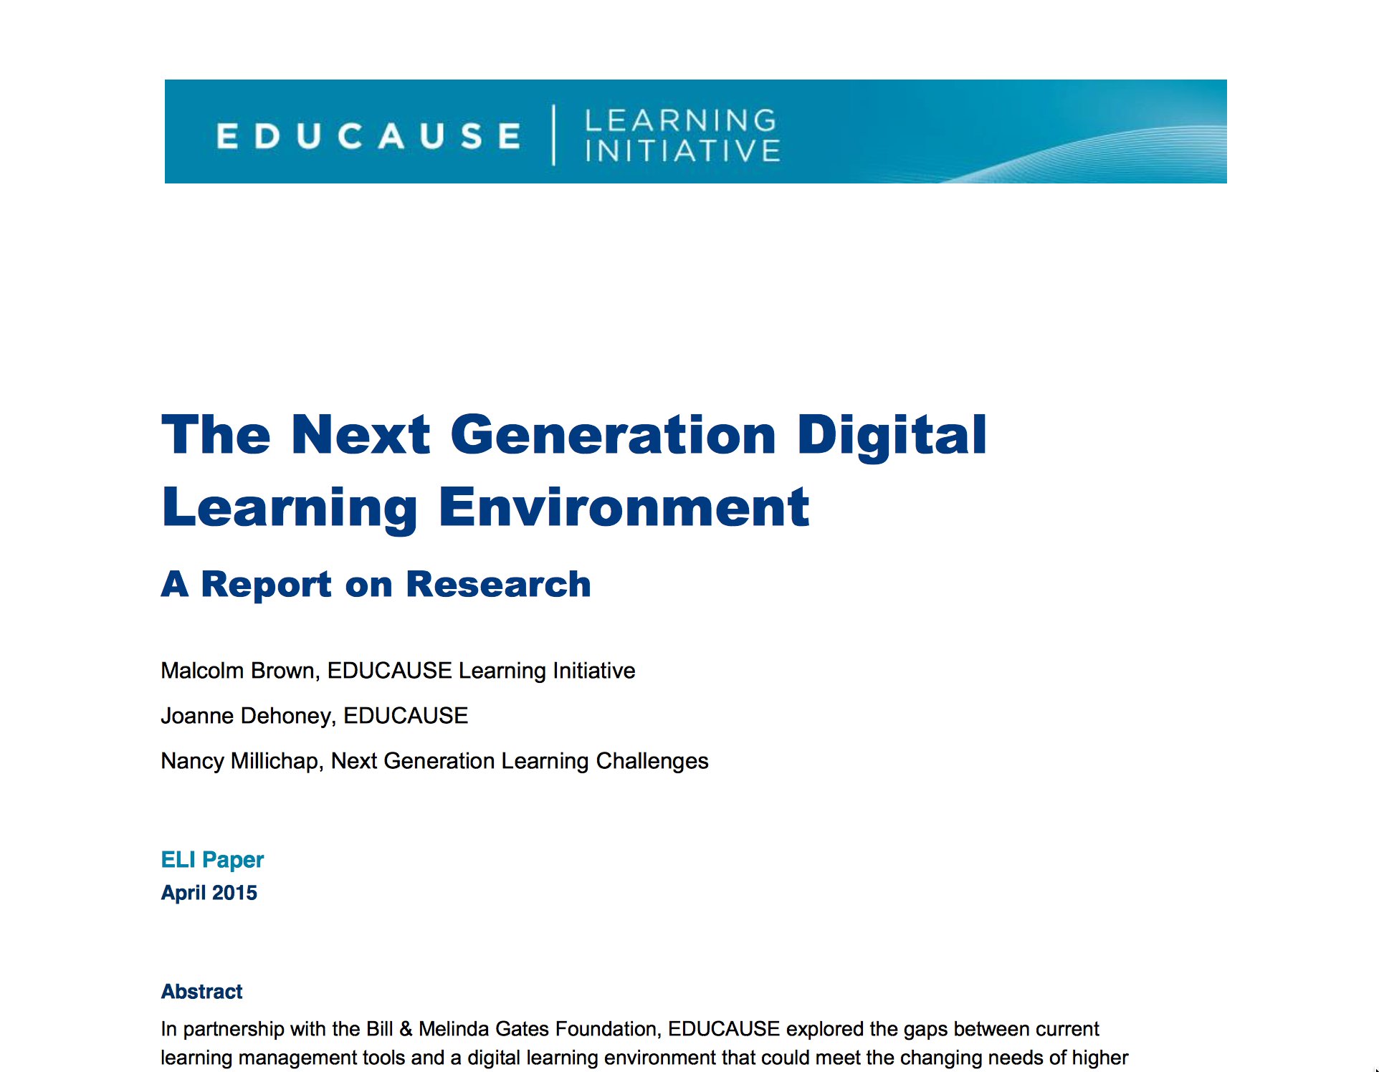
https://net.educause.edu/ir/library/pdf/eli3035.pdf

Slide 4
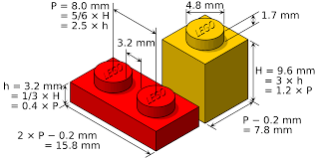
interoperability
Source: Malcolm Brown

Slide 5
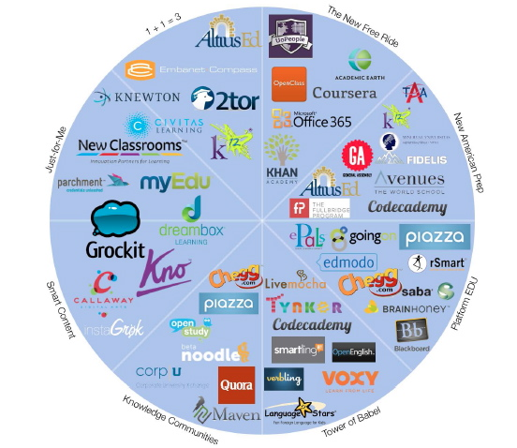
Historic
Levels of
Venture
Investment
in EdTech
Source: GSV: American
Revolution 2.0
http://gsvadvisors.com

Slide 6
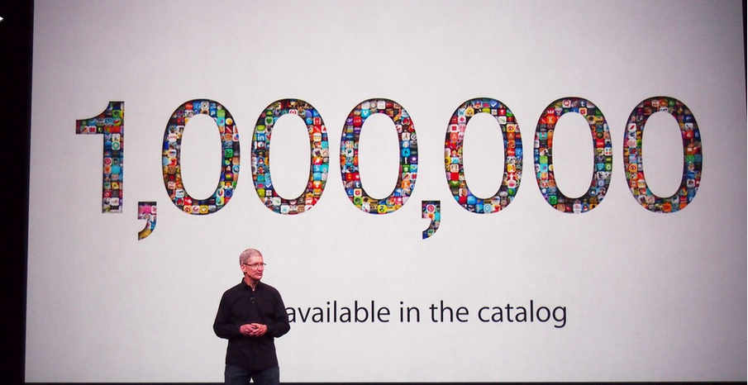
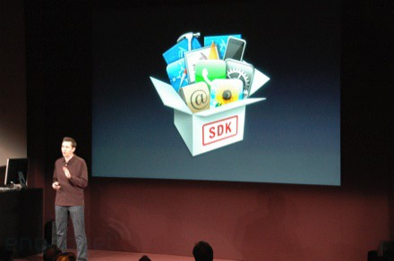
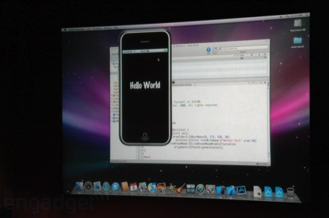
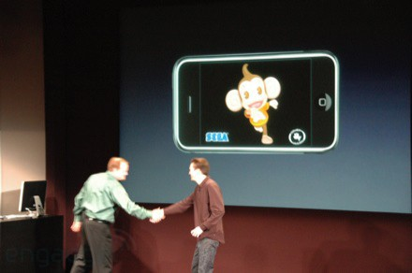
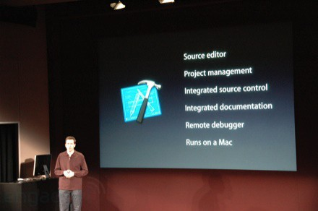
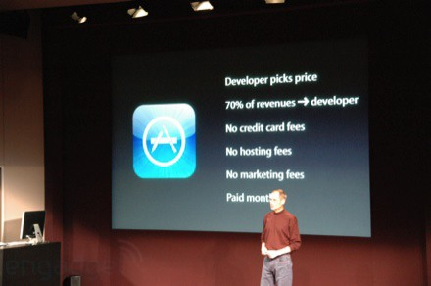
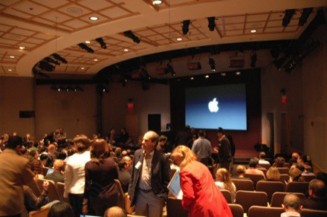
March 6, 2008 iPhone SDK Press Conference

Slide 7
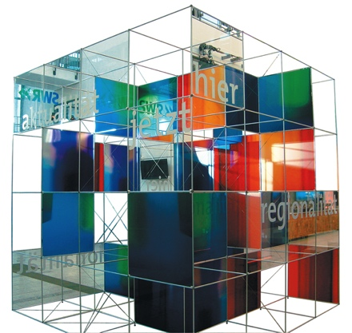
The Conclusion: The NGDLE is More Than an LMS
“An early conclusion from our research is that although the NGDLE might include a traditional LMS as a component, it will not itself be a single application like the current LMS or other enterprise applications. Rather, the NGDLE will be an ecosystem of sorts . . . “
https://net.educause.edu/ir/library/pdf/eli3035.pdf

Slide 8
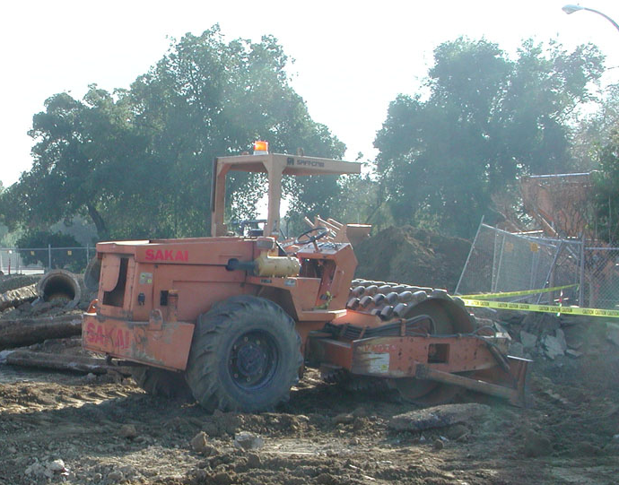
Getting to 100K Learning Applications
App Store Plumbing

Slide 9
What to Build
Rich Standards
Training for Developers
API Libraries – PHP, Java, Python, Node...
App Store for Learning Applications
Content Repositories
Learning Management Systems (many)

Slide 10


Expanding Standards
IMS Common Cartridge – 1.0, 1.1, 1.2, 1.3, 2.0
IMS Learning Tools Interoperability 1.0, 1.1, 2.0, 2.1, 2.2
IMS LTI Content Item - Public Draft
IMS LTI Roster Services – WG Draft
IMS LTI Outcomes Services – in WG Draft
IMS Caliper 1.0
IMS OneRoster – Rest-based SIS integration
IMS CASA App Store – WG – Draft
IMS CC / EPUB 3.0 Coordination

Slide 11
Advanced Issues in LTI Apps
Session Management / Expiry
Offline Grading – Peer grading Applications
Coping with unreliable Tool Consumers – Grade resend
Instructor grade detail

Slide 12
Tsugi
Console
Tsugi Store
MySQL
Database
APP
Tsugi
PHP
APP
APP
Canvas
Sakai
Coursera
…
APP
Tsugi
Java
APP
APP
LTI
APP
Tsugi
Node
APP
Python
Test
APP
Tsugi
…

Slide 13
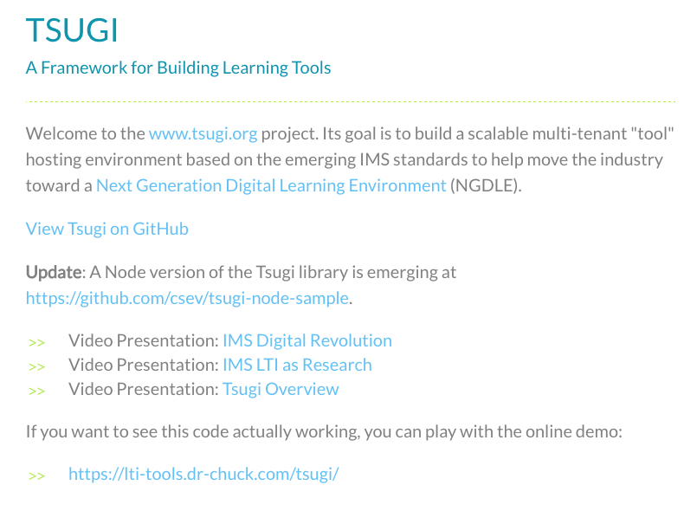
www.tsugi.org

Slide 14
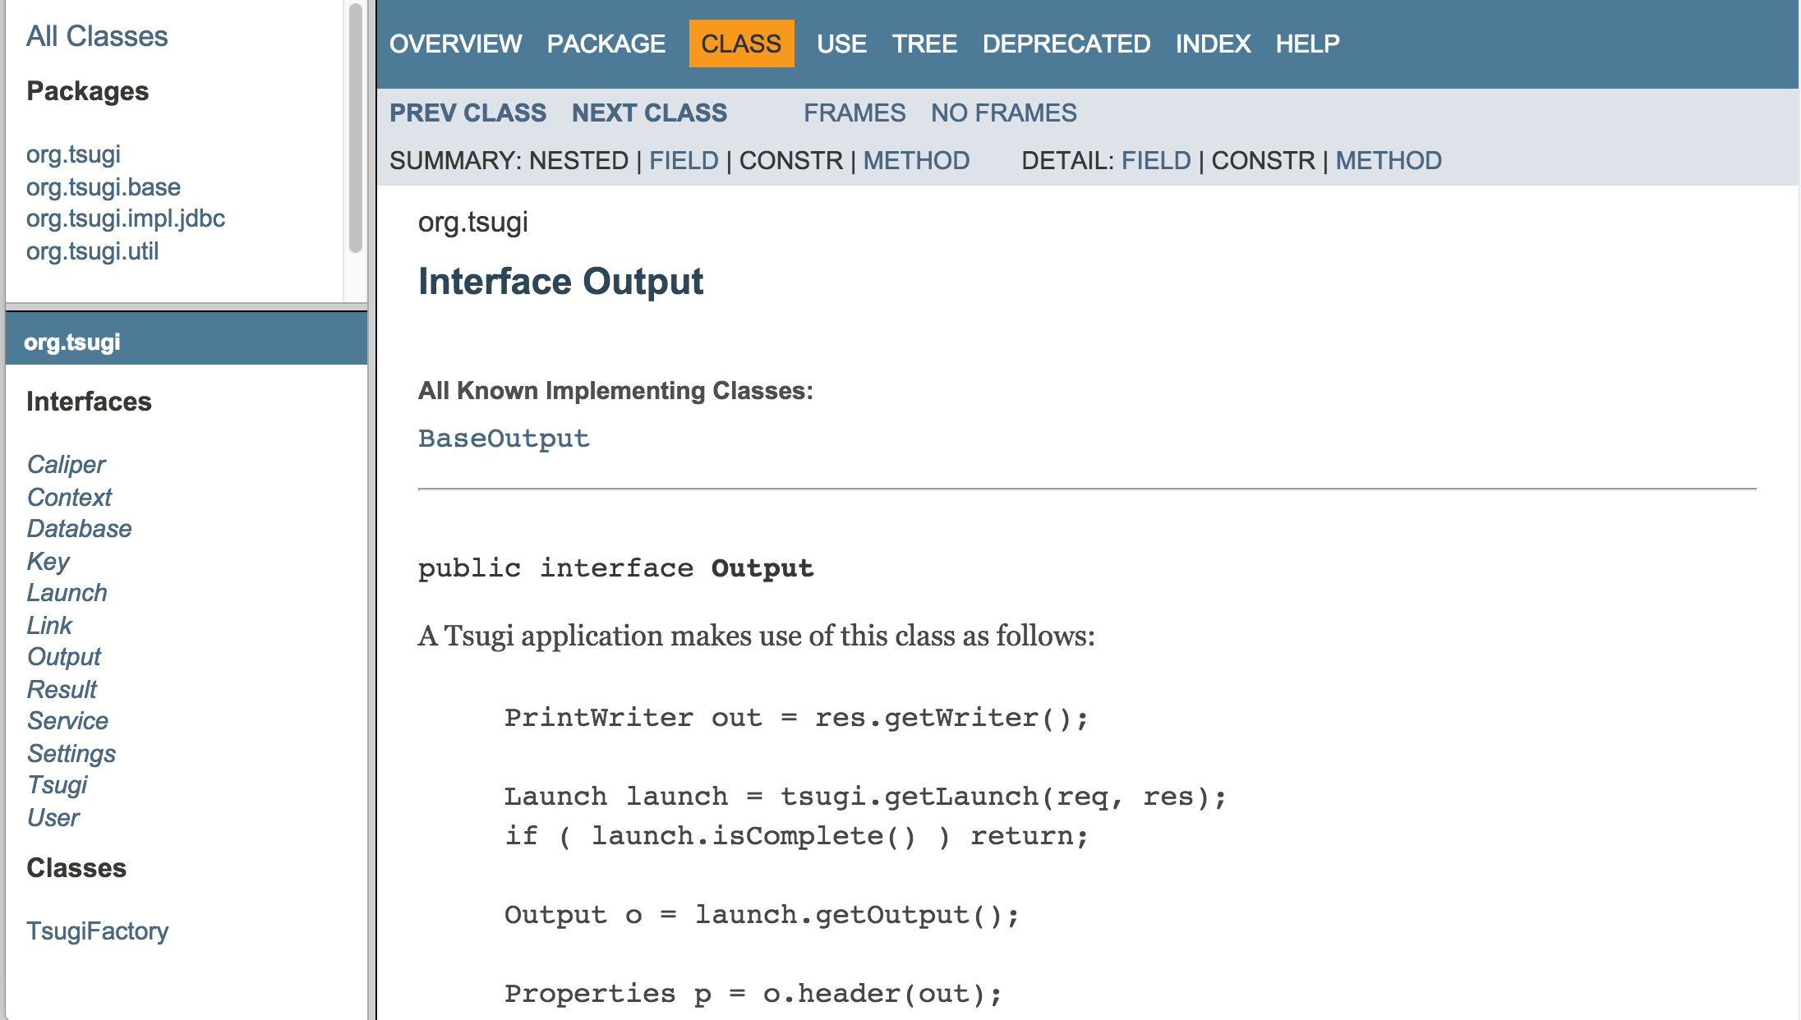
http://csev.github.io/tsugi-java/apidocs/index.html

Slide 15
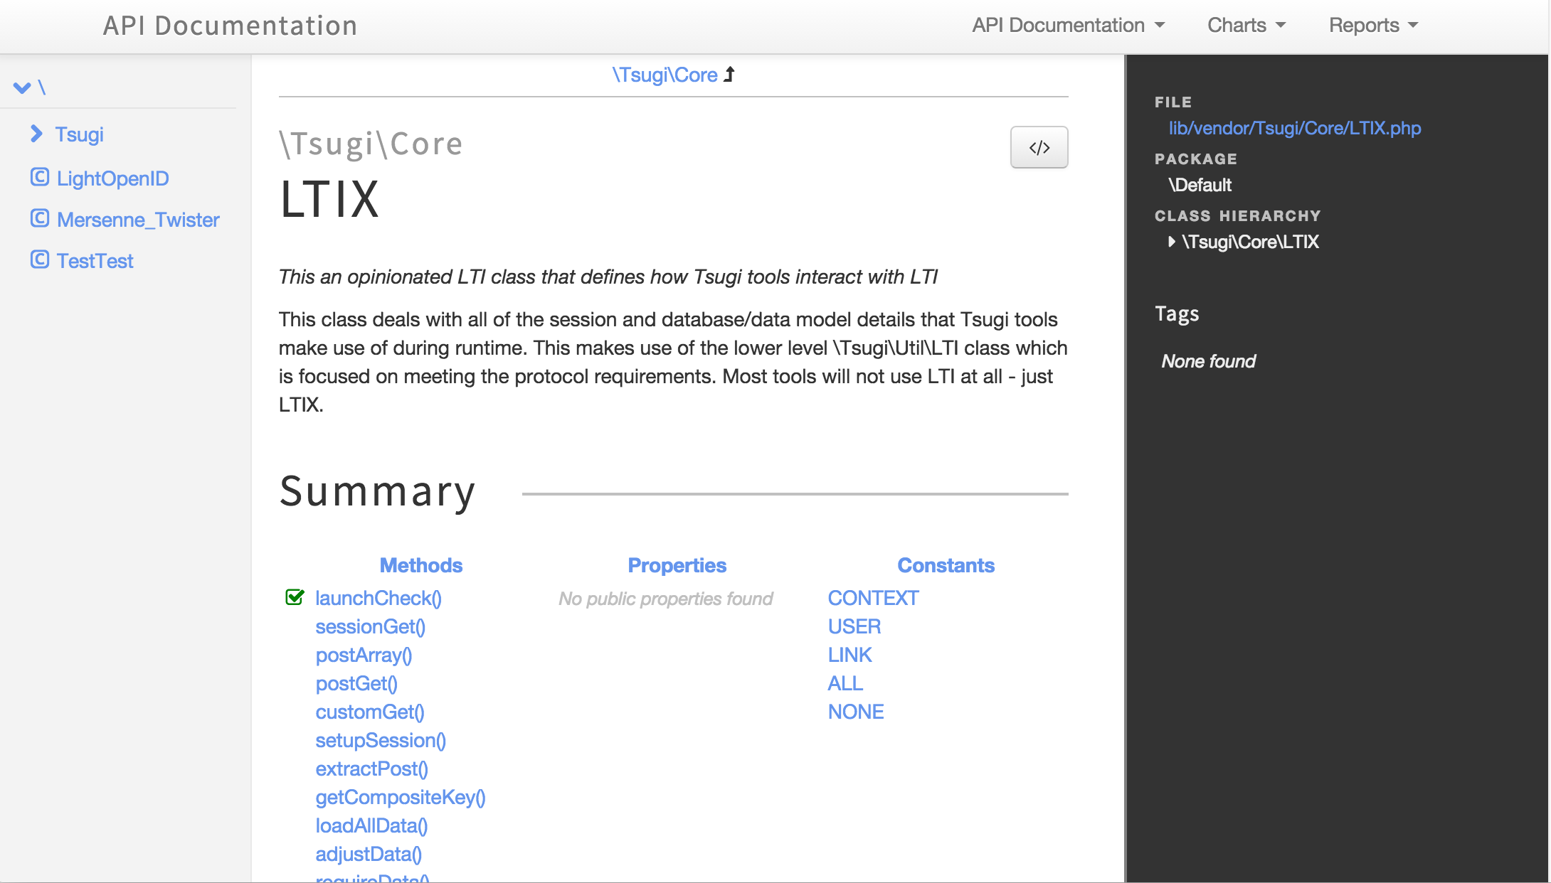
http://do1.dr-chuck.com/tsugi/phpdoc/classes/Tsugi.Core.LTIX.html

Slide 16
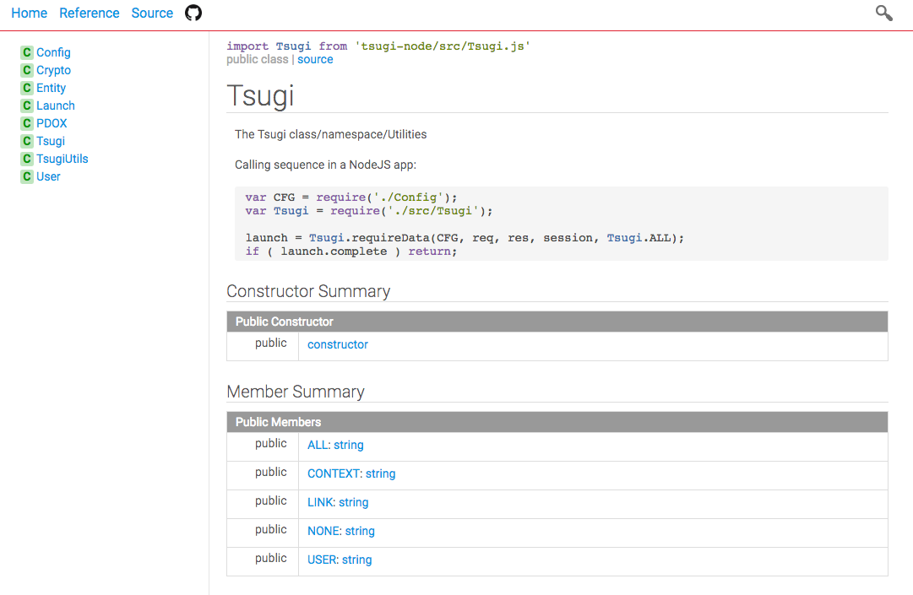
http://do1.dr-chuck.com/tsugi-node/esdoc/

Slide 17
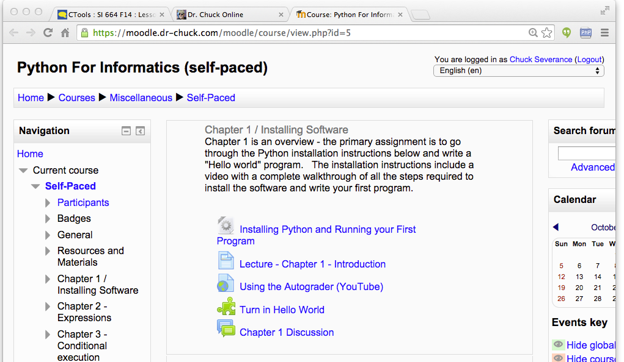
Tenant
Context
User
Link (Many)

Slide 18
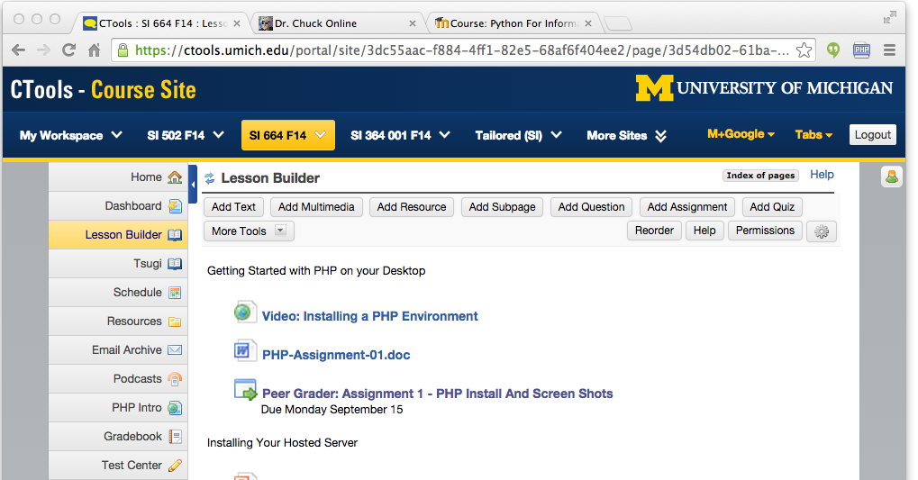
Tenant
Context
User
Link (Many)

Slide 19
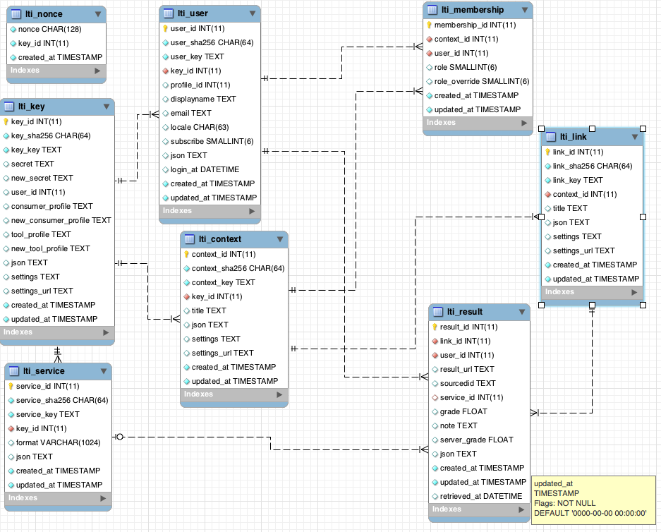
tsugi/docs/lectures/02-Data-Model-Workbench.mwb

Slide 20
Tsugi Tools To Date
App Store
Google Class Map
GIFT Quiz Engine
Grade book
Attendance Tool
Video Tracker (*)
Clicker (*)
HTML5 Autograder
Python Autograder
SQL Autograder
DataMining Autograder
PHP Autograder
https://lti-tools.dr-chuck.com/tsugi Developer -> "secret"

Slide 21
Tsugi Developer Training
PHP / MySQL – www.php-intro.com
Tsugi Recorded Lecture Series
http://lectures.tsugi.org/
Lots of sample code
Assignments for Developer Workshop
Grade, Chat, Map, Wisdom of Crowds
https://github.com/csev/tsugi-php-exercises

Slide 22
Tsugi Production
Auto grading and peer grading for Coursera
pr4e.dr-chuck.com – 214353 user accounts
On campus Sakai/Canvas/Blackboard and demo accounts
lti-tools.dr-chuck.com
My own free course service
online.dr-chuck.com
Static assets on CloudFlare CDN
https://www.dr-chuck.net/tsugi

Slide 23
GitHub Structure
Develop, Manage, Administration, App Store Console
https://github.com/csev/tsugi
PHP Tsugi
https://github.com/csev/tsugi-php
Modules: https://github.com/csev/tsugi-php-mod
Sample Module: https://github.com/csev/tsugi-php-module
Sample App: https://github.com/csev/tsugi-php-standalone
Exercises: https://github.com/csev/tsugi-php-exercises
Application: https://github.com/csev/tsugi-php-slack

Slide 24
GitHub Structure
Node Tsugi
Library: https://github.com/csev/tsugi-node
LTI Library: https://github.com/csev/tsugi-node-lti
Sample Application: https://github.com/csev/tsugi-node-sample
Java Tsugi
Library: https://github.com/csev/tsugi-java
Sample Application: https://github.com/csev/tsugi-java-servlet
Functionality Test (Python):
https://github.com/csev/tsugi-python-test

Slide 25
IMS Content Item and IMS CASA
One of Many of the upcoming new Specifications

Slide 26
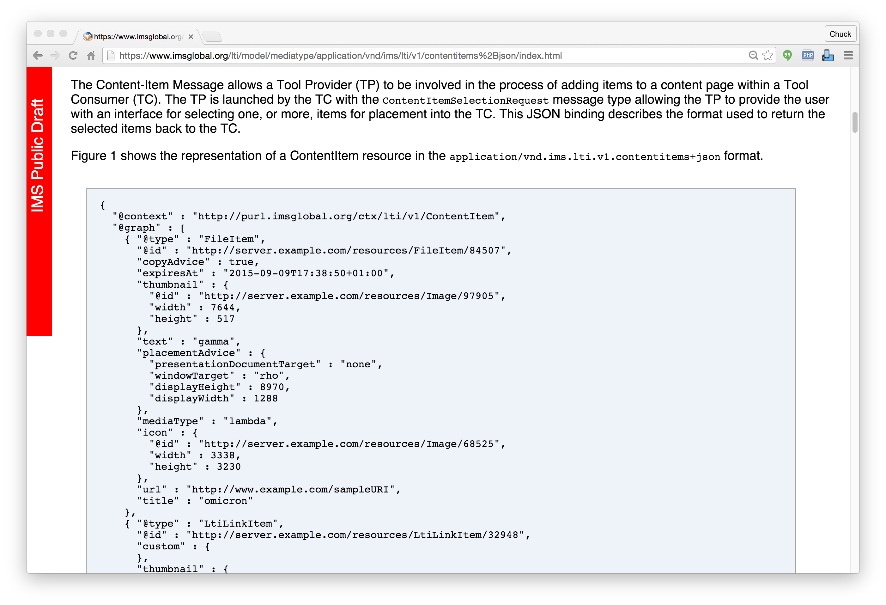
IMS
Content
Item
https://www.imsglobal.org/specs/lticiv1p0

Slide 27

IMS Content Item Launch
APP
Launch Picker
APP
LMS
APP
Launch Picker
Content
Repository

Slide 28
IMS Content Item Return
APP
LMS
APP
APP
APP
URL, Configuration
Content
Repository
IMS Common
Cartridge (ZIP File)

Slide 29
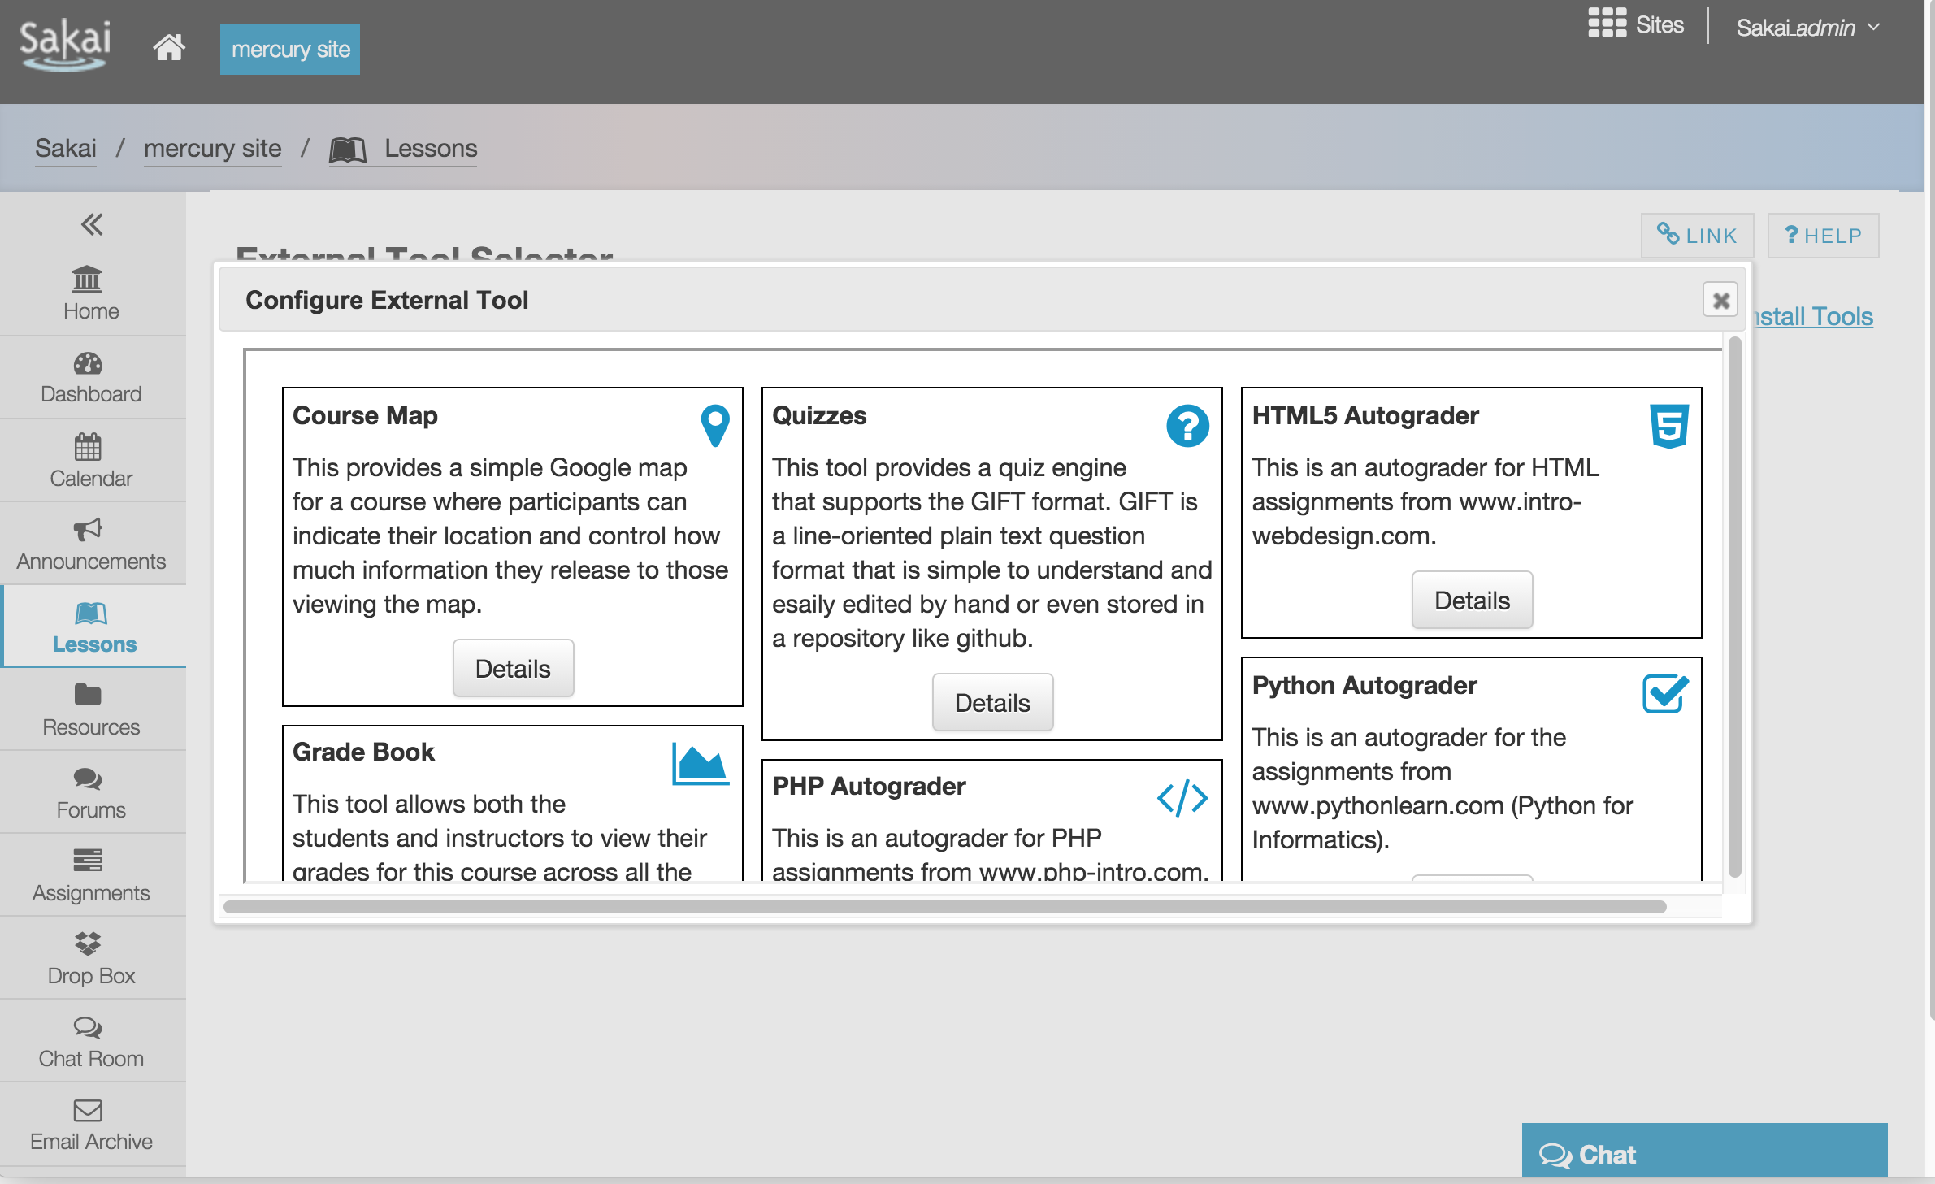

Slide 30
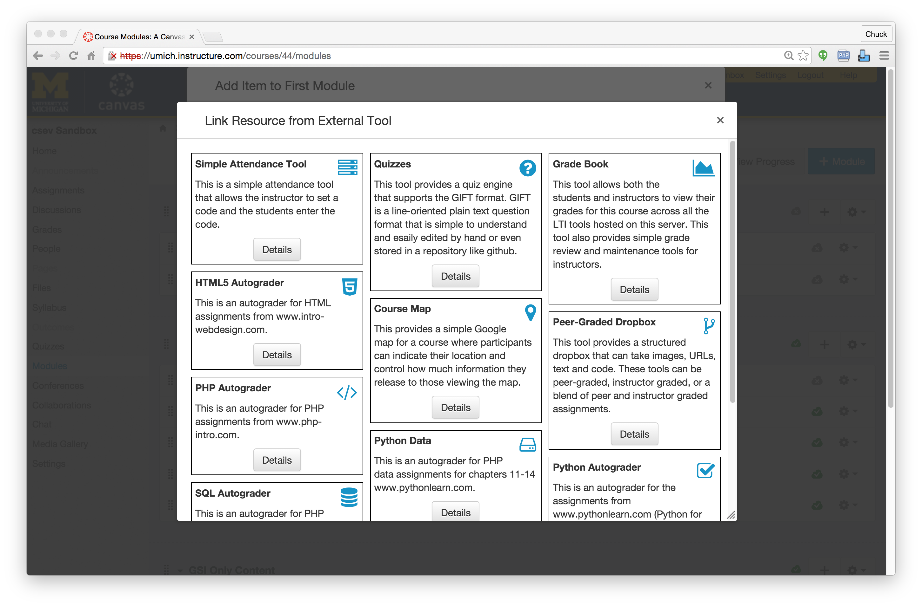

Slide 31
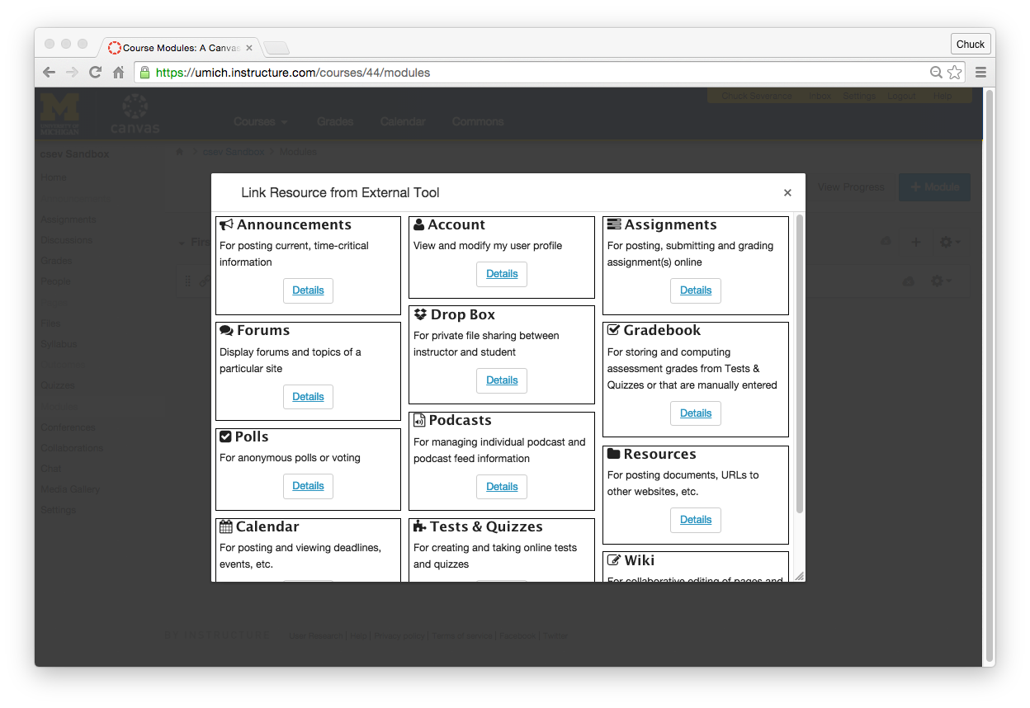

Slide 32
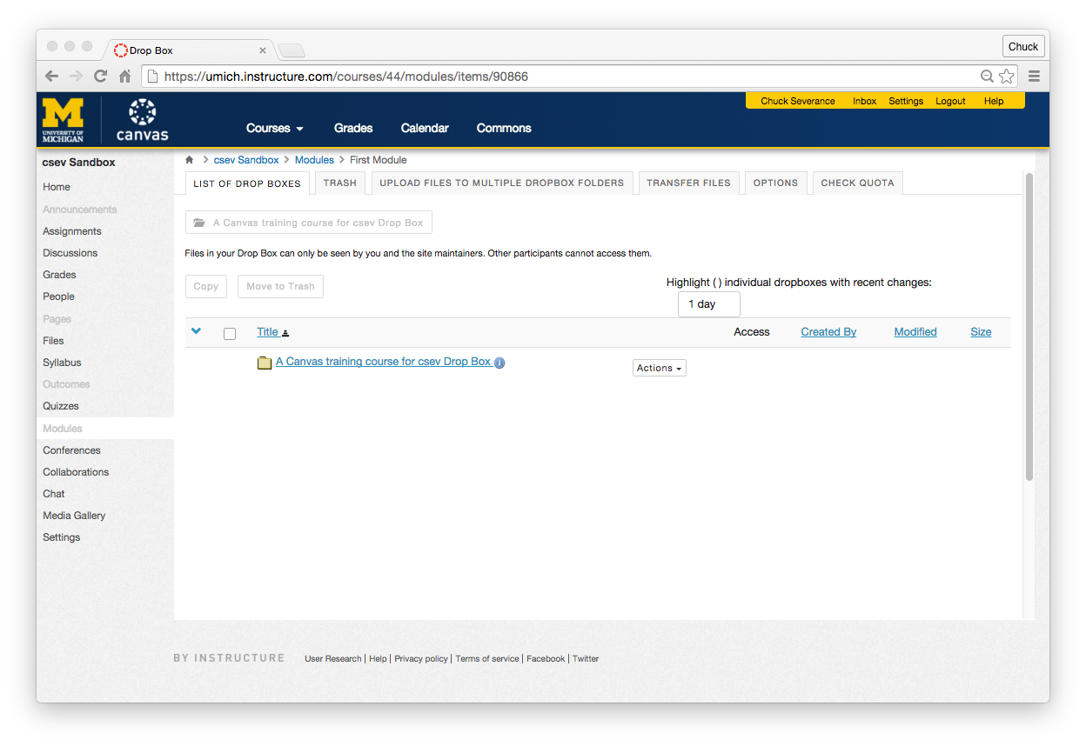

Slide 34
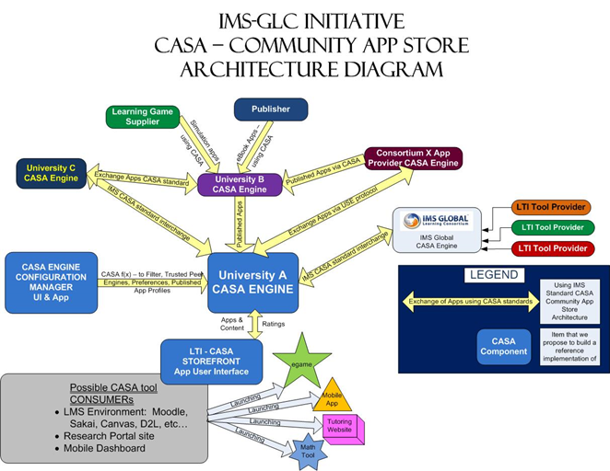

Slide 35
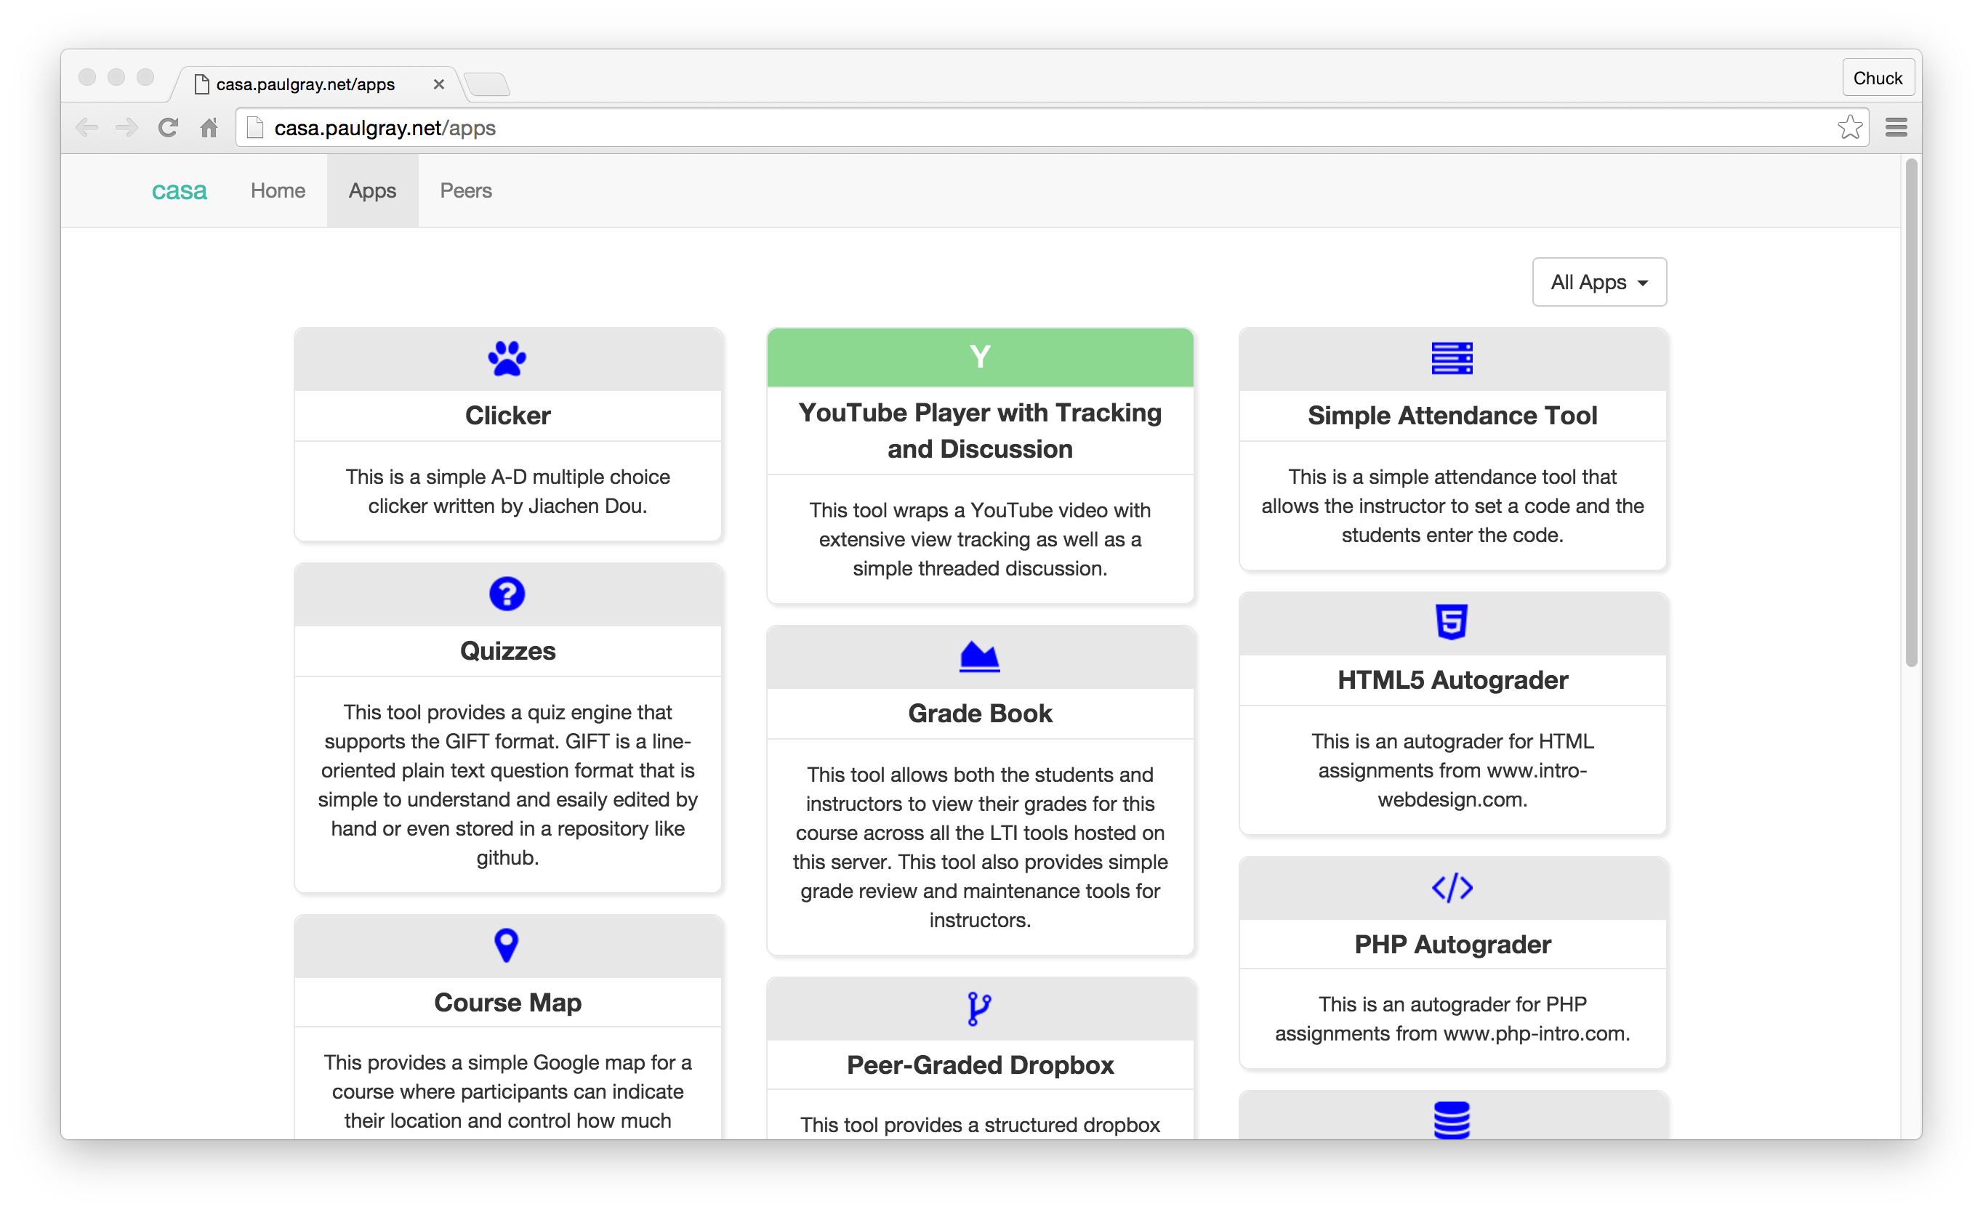

Slide 36
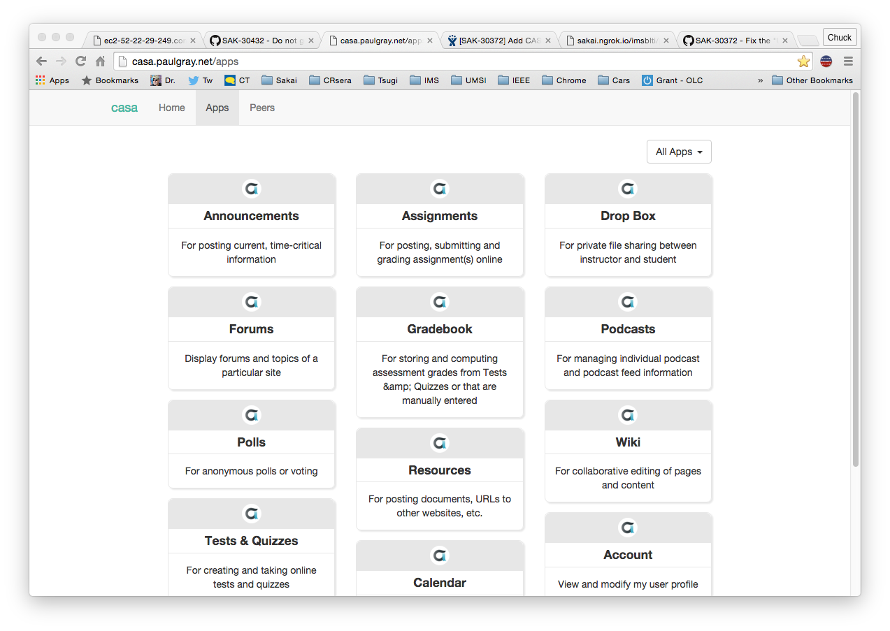

Slide 37
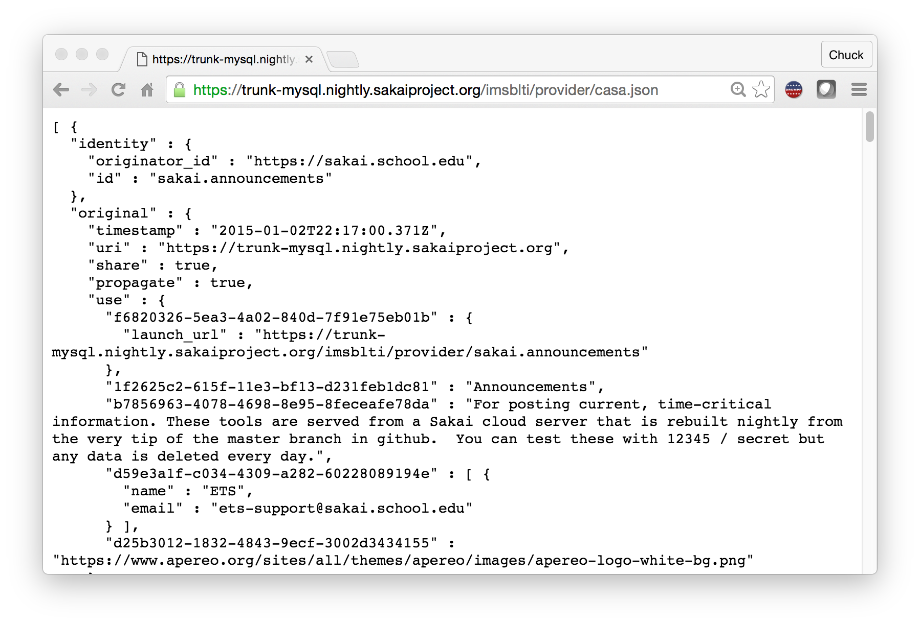

Slide 38


CASA
App Store
IMS CASA
IMS ContentItem

Slide 39
Standards Score Card
LMS | LTI 1.x | Content Item | LTI 2.x | CASA
Canvas | A | A | B+
Sakai | A | A- | A- | B
Moodle | A | B-
D2L | A
Blackboard | A
Tsugi | A+ | A | A+ | B

Slide 40
In the Future
There will be many specialized LMSs with limited built in features
Most features come from app stores (also plentiful)
Book, web site, and course authoring will merge
Content will play in many different LMS systems
App stores will have > 100K apps / content
There will be business models beyond CIO to vendor
Teacher to vendor / Teacher to teacher / Student to vendor

Slide 41
NGDLE Experiments...
Repositories
Blackboard xpLor
Canvas Commons
App Store:
Canvas EduAppCenter
ELMS Network – Drupal + LTI Provider
Tsugi – www.tsugi.org
Small LMS + App Store + Marketed t to Teacher
Edmodo – App Store not LTI
Schoology – App Store with LTI

Slide 42
When?
A (lucky) Teacher's Perspective

Slide 43
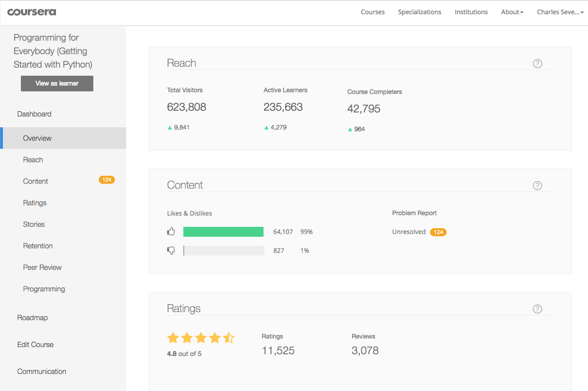

Slide 44
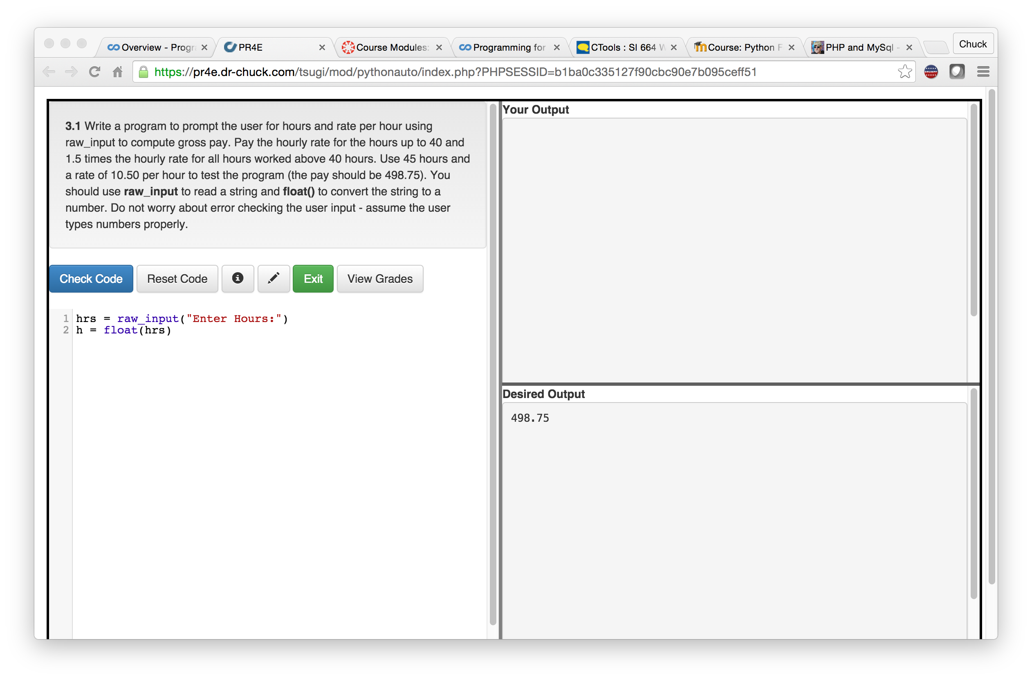

Slide 45
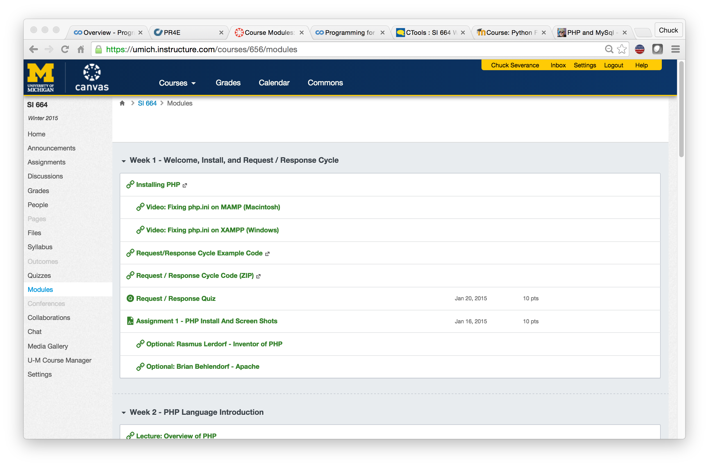

Slide 46
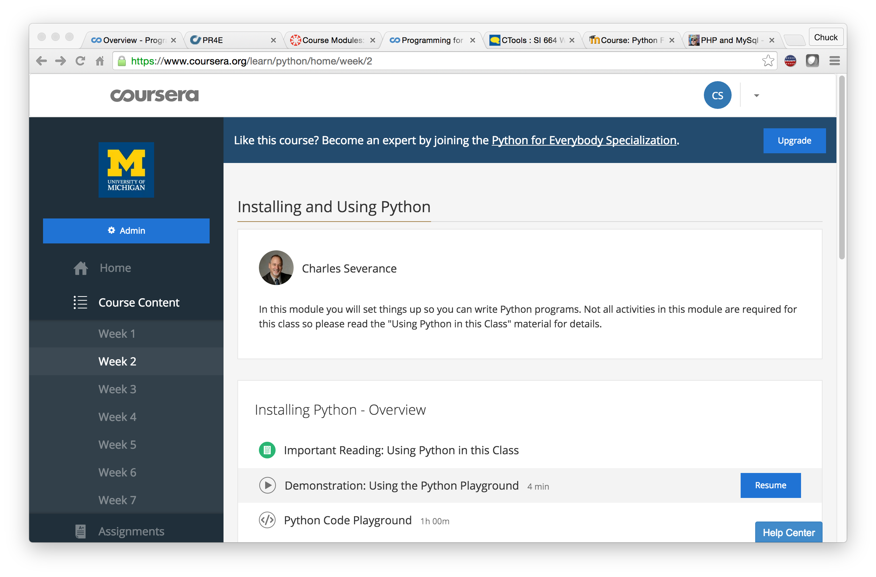

Slide 47
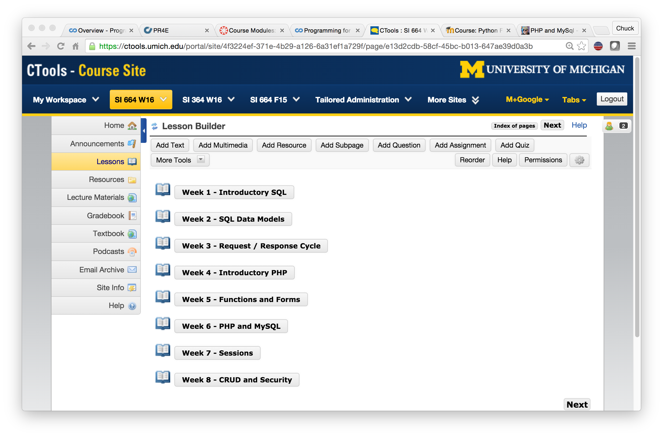

Slide 48
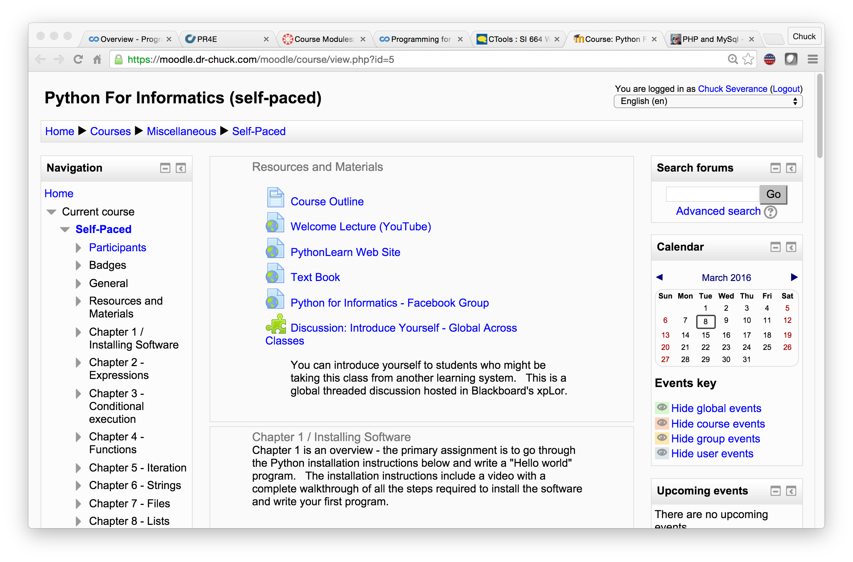

Slide 49
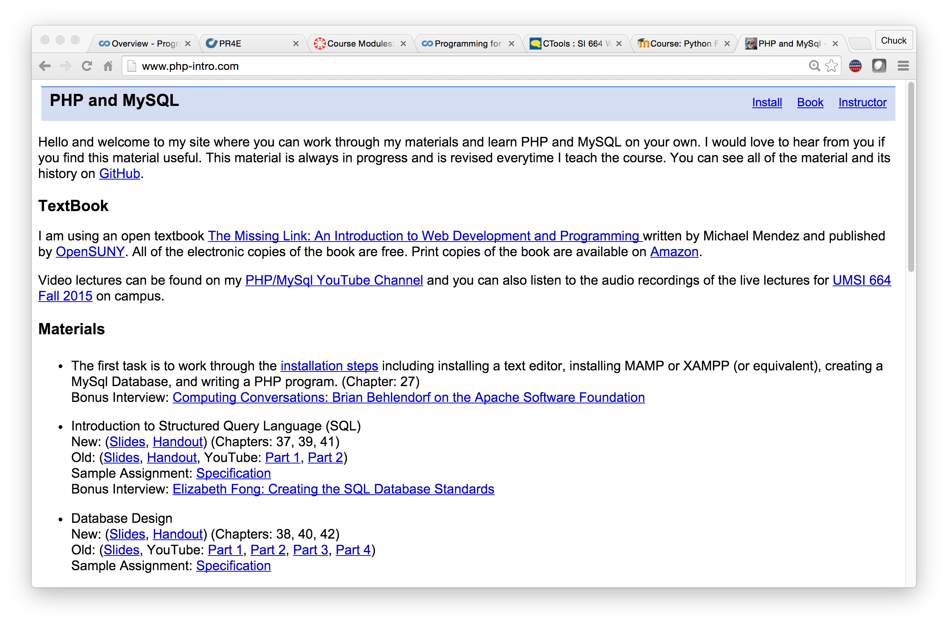

Slide 51
The Conclusion: The NGDLE is More Than an LMS
“An early conclusion from our research is that although the NGDLE might include a traditional LMS as a component, it will not itself be a single application like the current LMS or other enterprise applications. Rather, the NGDLE will be an ecosystem of sorts . . . “
https://net.educause.edu/ir/library/pdf/eli3035.pdf

Slide 52
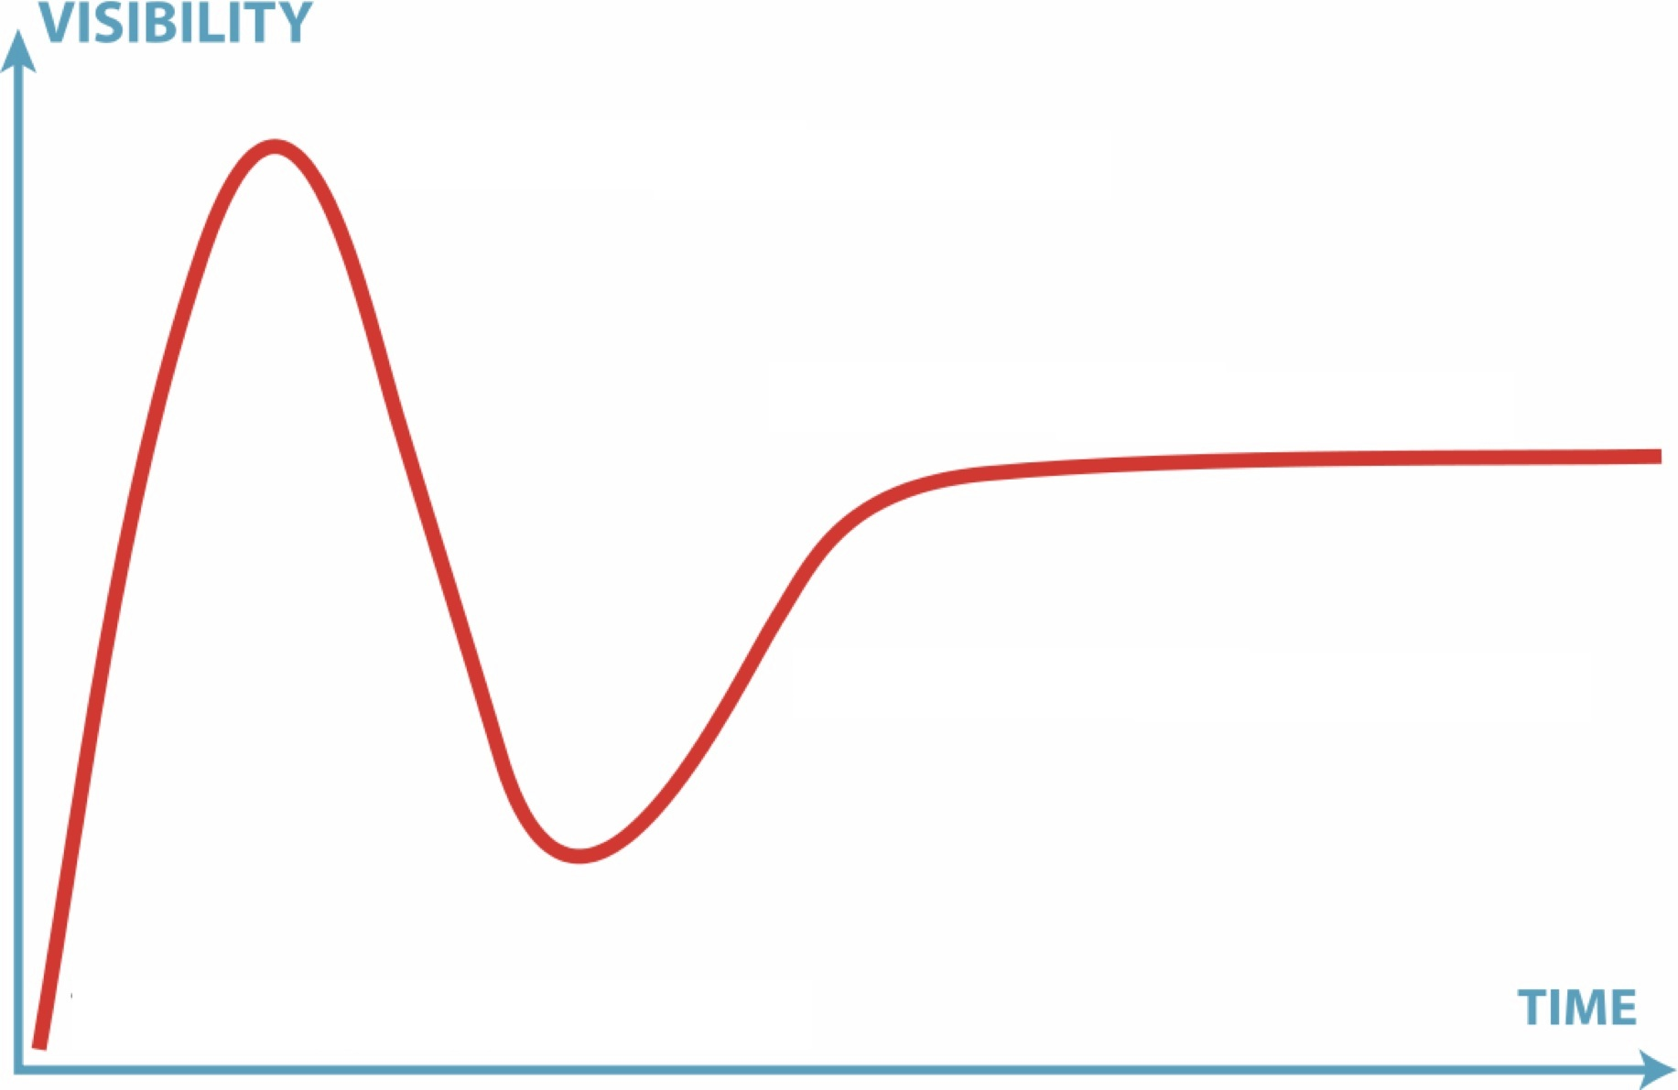

11
2.9
10
2.6
2.7
2.8
2.5
2.0
1.0
1.5
2016

Slide 53

11
2.9
10
2.6
2.7
2.8
2.5
2.0
1.0
1.5
2004
2016

Slide 54
12
11
2.9
10
2.6
2.7
2.8
2.5
2.0
1.0
1.5
2004
2017

Slide 55
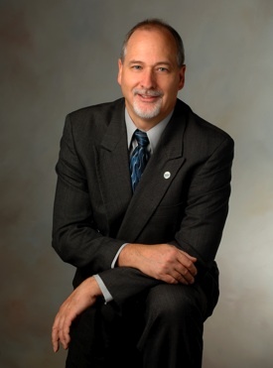

In building the NGDLE, open source will be first to market..

Slide 56
Next Steps(August 2016)
Tsugi Hackathon
Marist University, August 11, 12 2016
http://www.marist.edu/tsugi/
Embedding Tsugi PHP in web content site
http://www.php-intro.com/
Mentor Tsugi / Python
Better understand Tsugi / Node

